Slide 1
Point Of Sale

Slide 2
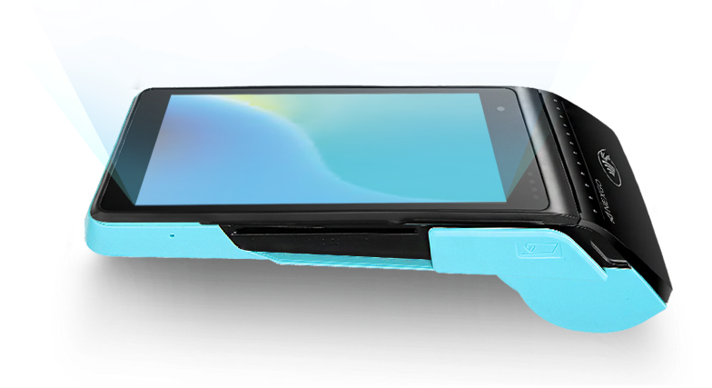
Nexgo N5 Smart

Slide 3
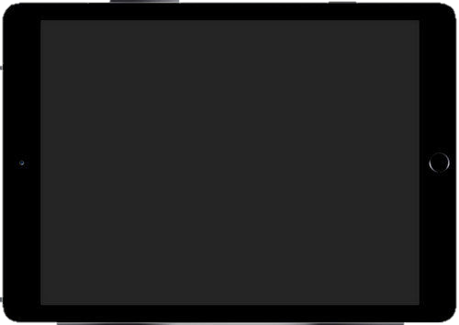
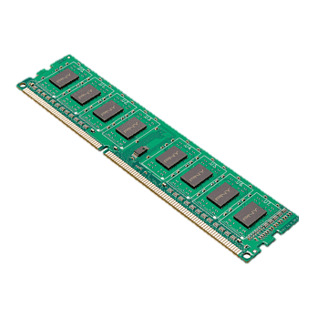


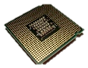





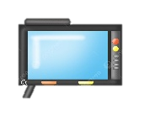
1GB RAM + 8GB ROM (Micro SD Card Supported up to 128GB)
Magnetic stripe cards - Chip Cards - Contactless Cards
Memory
Card Reader
High Speed Thermal Printer (4 receipts per minute)
Quad-core: ARM Cortex-A7, 1.1GHz
Printing
Processor
4G/3G/2G - Wi-Fi 2.4GHz（802.11/b/g/n） - BT 4.0
Capacitive Touchscreen - 1 Power Key - 2 Volume Keys
Communication
Keypad
417g with battery
3.7V/5200mAh Rechargeable Li-ion Battery
Weight
Battery
5.5" HD (1280 × 720) Color Screen
350$
Display
Price

Slide 4
Extras
FingerGPS Positioning.
print Identification.
1x Speaker.

Slide 5
Points Rating System
Memory | Printing | Communication | Weight | Display | Card Reader | Processor | Keypad | Battery | Extras
8 | 7.5 | 8 | 8 | 8.5 | 7 | 8 | 8 | 8.5 | 5
=
4.5 dollars/point

Slide 6
THANK YOU

